Slide 1
Glass Fibre Reinforced Epoxy Casing System for Geothermal Application

Slide 2
Project Objectives
GRE Product:
The projects main objective is to develop a cost-reducing glass-fiber reinforced epoxy piping that is especially designed for low enthalpy geothermal well application (up to 100°C) with relatively large inside diameter and reduced outside diameter. This especially concerns the pipe coupling, which would allow an installation in new wells as well as utilization for workover of old wells.
Code, Verification & Handling:
Furthermore, the project will include the much-needed guidelines (standard / code) plus tools for the design and qualification of the GRE piping system, combined with pipe and coupling wear & load (collapse, burst, tensile) testing and verification (4 quadrant service envelope). Additionally, handling tools for the installation of the GRE piping system are designed / improved during the project.

Slide 3
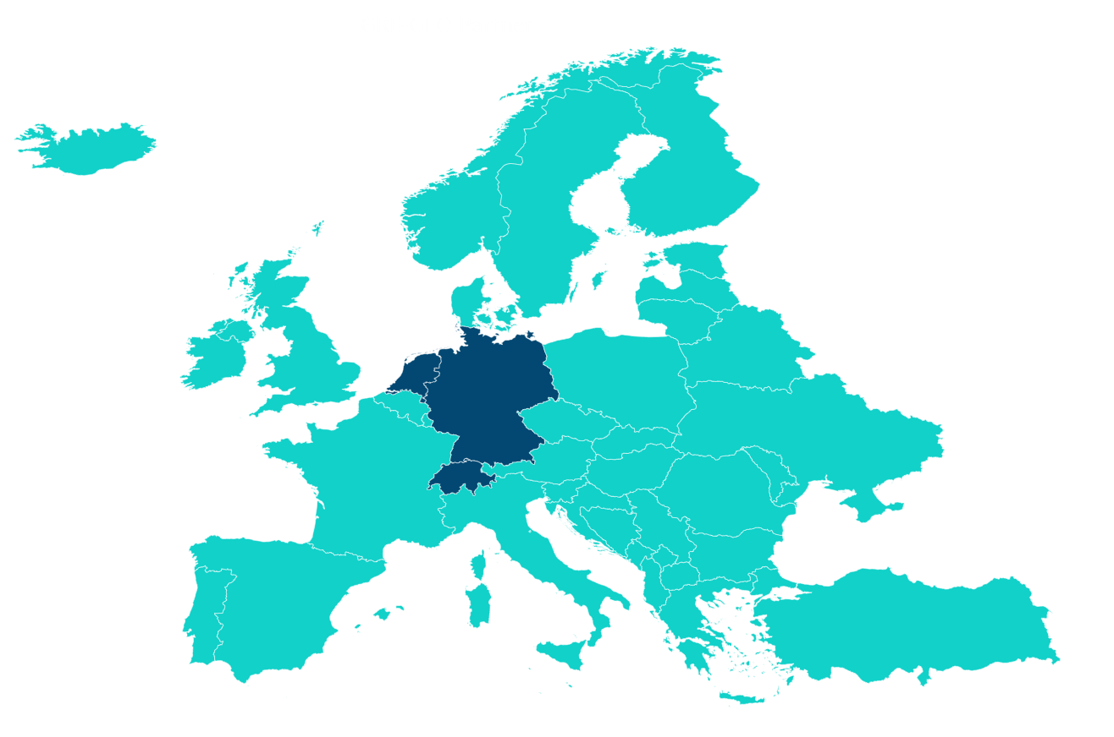
Introduction to Consortium Members
The International consortium consists field experts from 3 European Countries:
Germany
  VEE - Geothermal Plant Engineering & Design
  ITE - Institute of Subsurface Energy Systems
  DrillTec- Deep Drilling and Well Design
Netherlands
  FPI – Manufacturer of Fiberglass Piping
  DRG – Engineering & Consulting for Piping & pressure Vessels
  NRG – Nuclear Research & Consulting
Switzerland
  Eartha – Expert in Reservoir Engineering
Netherlands
Germany
Switzerland

Slide 4
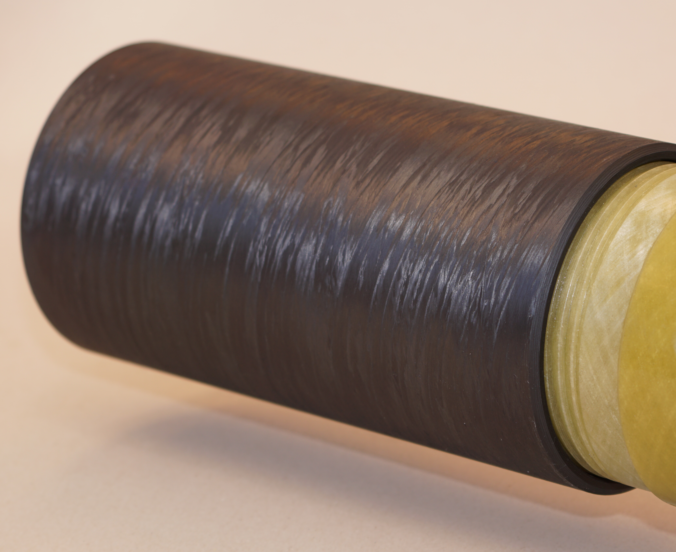
Advantages of the Gre material
Extreme acid, salinity and alkalinity resistance
High insulation in comparison to steel
Less pressure losses, less deposition potential
Lower price compared to high steal alloys
Advanced properties due to hybrid coupling
Long Term Stability

Slide 5
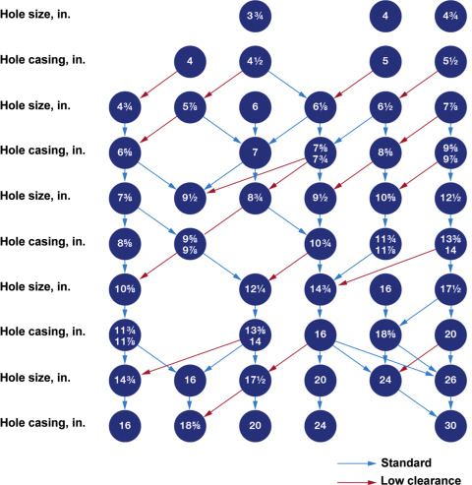
Product diameter selection
Boundary values:
Aimed drift diameter: 17,59“ – 18,94“
Maximal casing diameter : 16”
Optimal casing diameter : 13 3/8” – 14”
GRE casing OD – will be optimized and defined during tests.
Goals reminder:
Primary Goal: Development of a casing string.
Secondary Goal: Development of a production string (inner string or tubing).
William Lyons, Norton J. Lapeyrousse, in Formulas and Calculations for Drilling, Production, and Workover (Third Edition), 2012

Slide 6
Market Research
In order to define the generalized well design an extensive market study was performed.
Results Summary
Most common Casing Sizes: 13 3/8” and 9 5/8”
Surface Casing Sizes: 28” - 18 5/8”
Older wells have smaller Diameters
Average depth: 2359 m TVD
Common Well Architecture : Conductor, 2 Casings and 2 Liners.
Sources: 1) NLog Data
2) Stakeholder survey

Slide 7
Product diameter Finalization
Surface Casing
Conventional C-Steel: 26-22”
Production Casing
Replacement for conventional: 13 3/8” – 14”
Maximal casing ID : 308 mm or 12 1/8”
GRE casing OD : 17 ½”
Production Liner
Replacement for conventional: 9 5/8”
Maximal casing ID : 200 mm
GRE casing OD : 11 1/10”
Drift Diameter : 7 ¾” or 196,85 mm
Follow up Options
Conventional piping OD: 6 1/8”

Slide 8
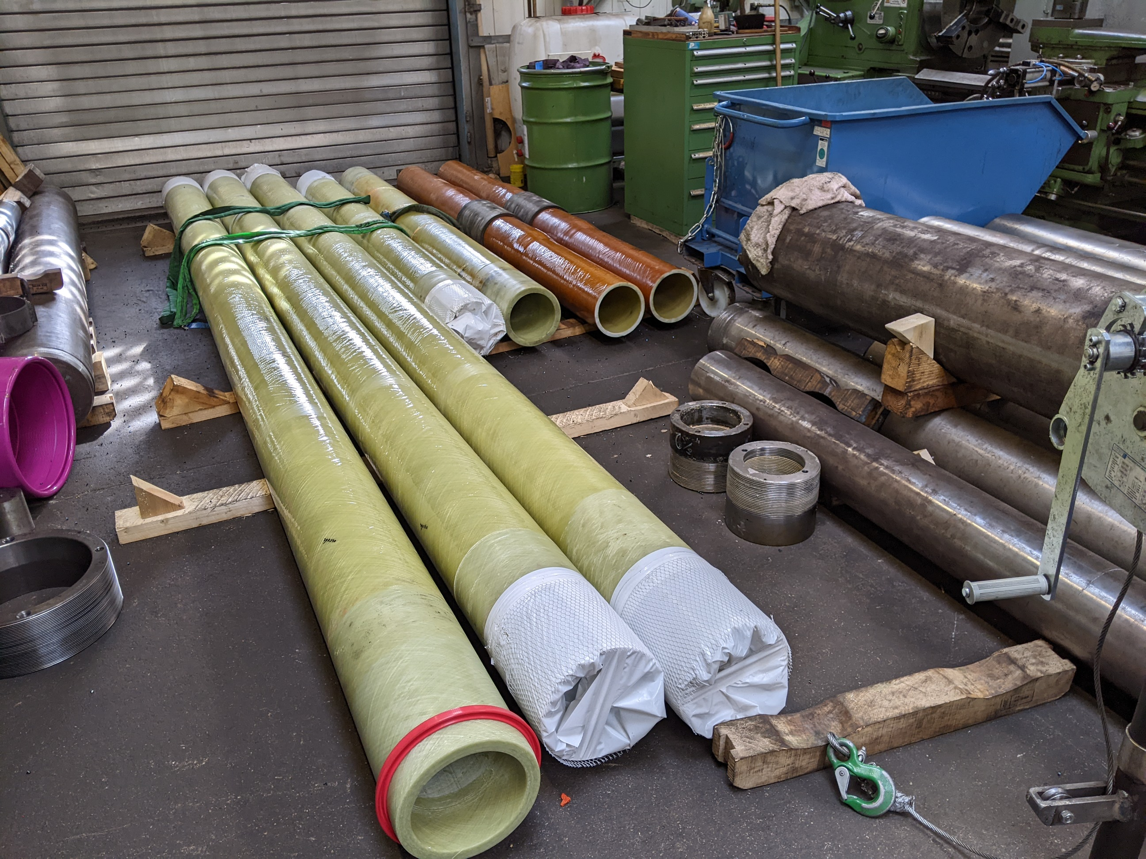
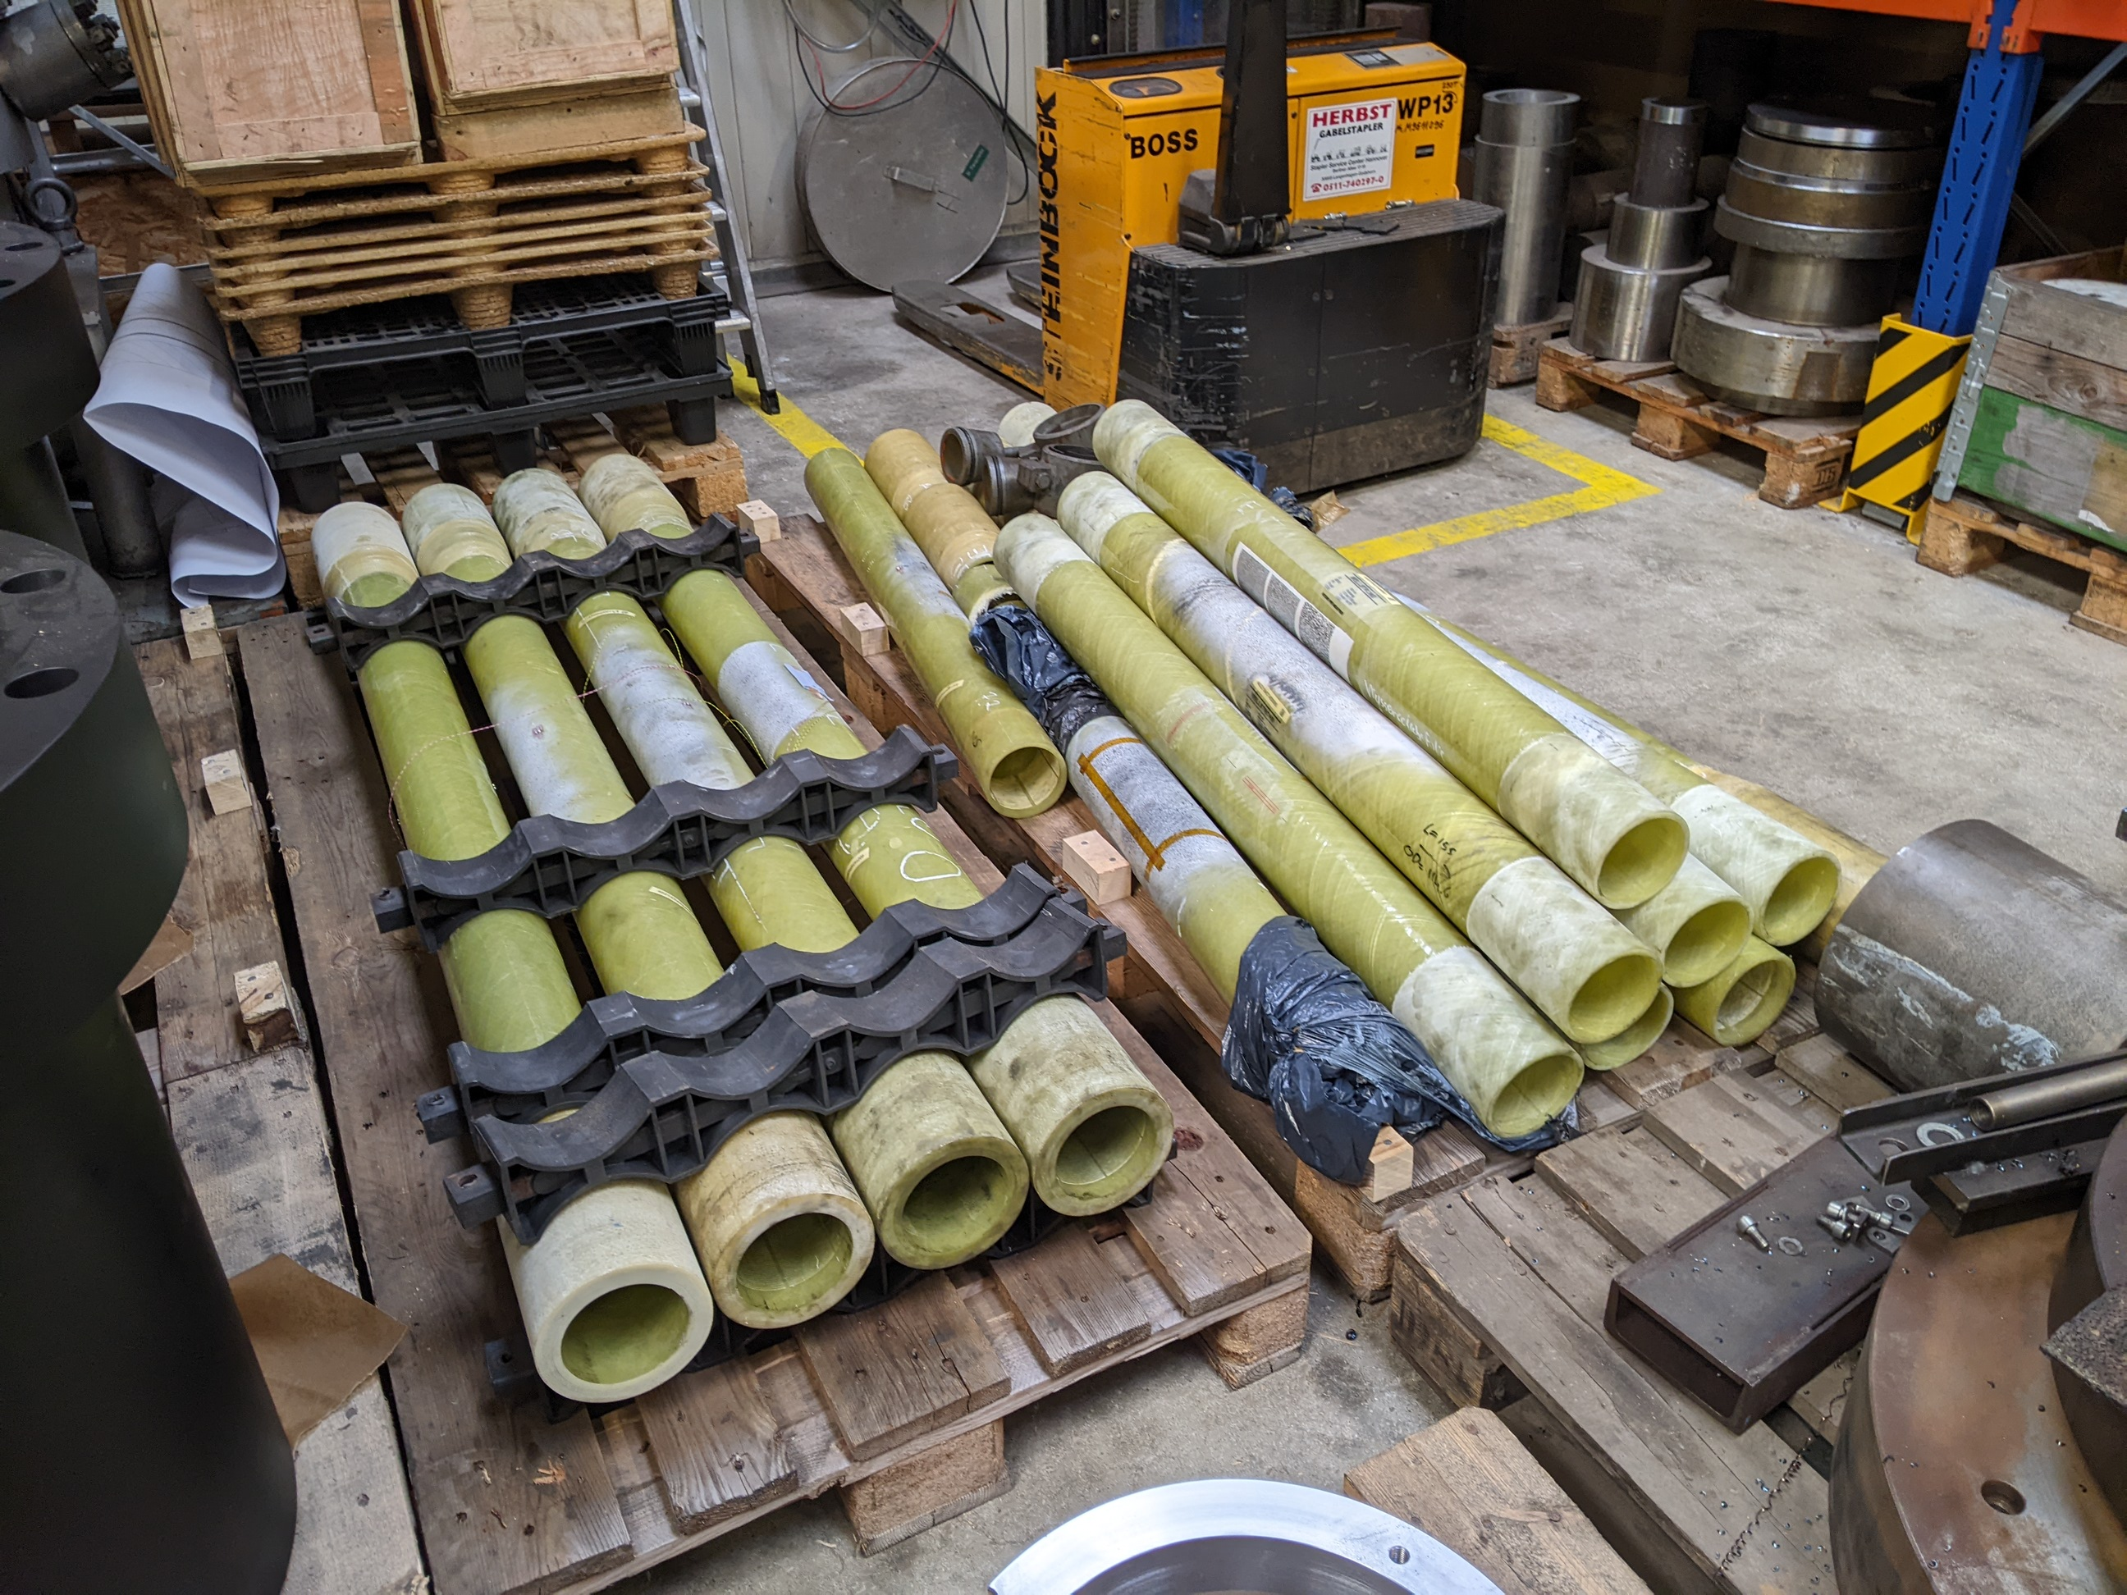
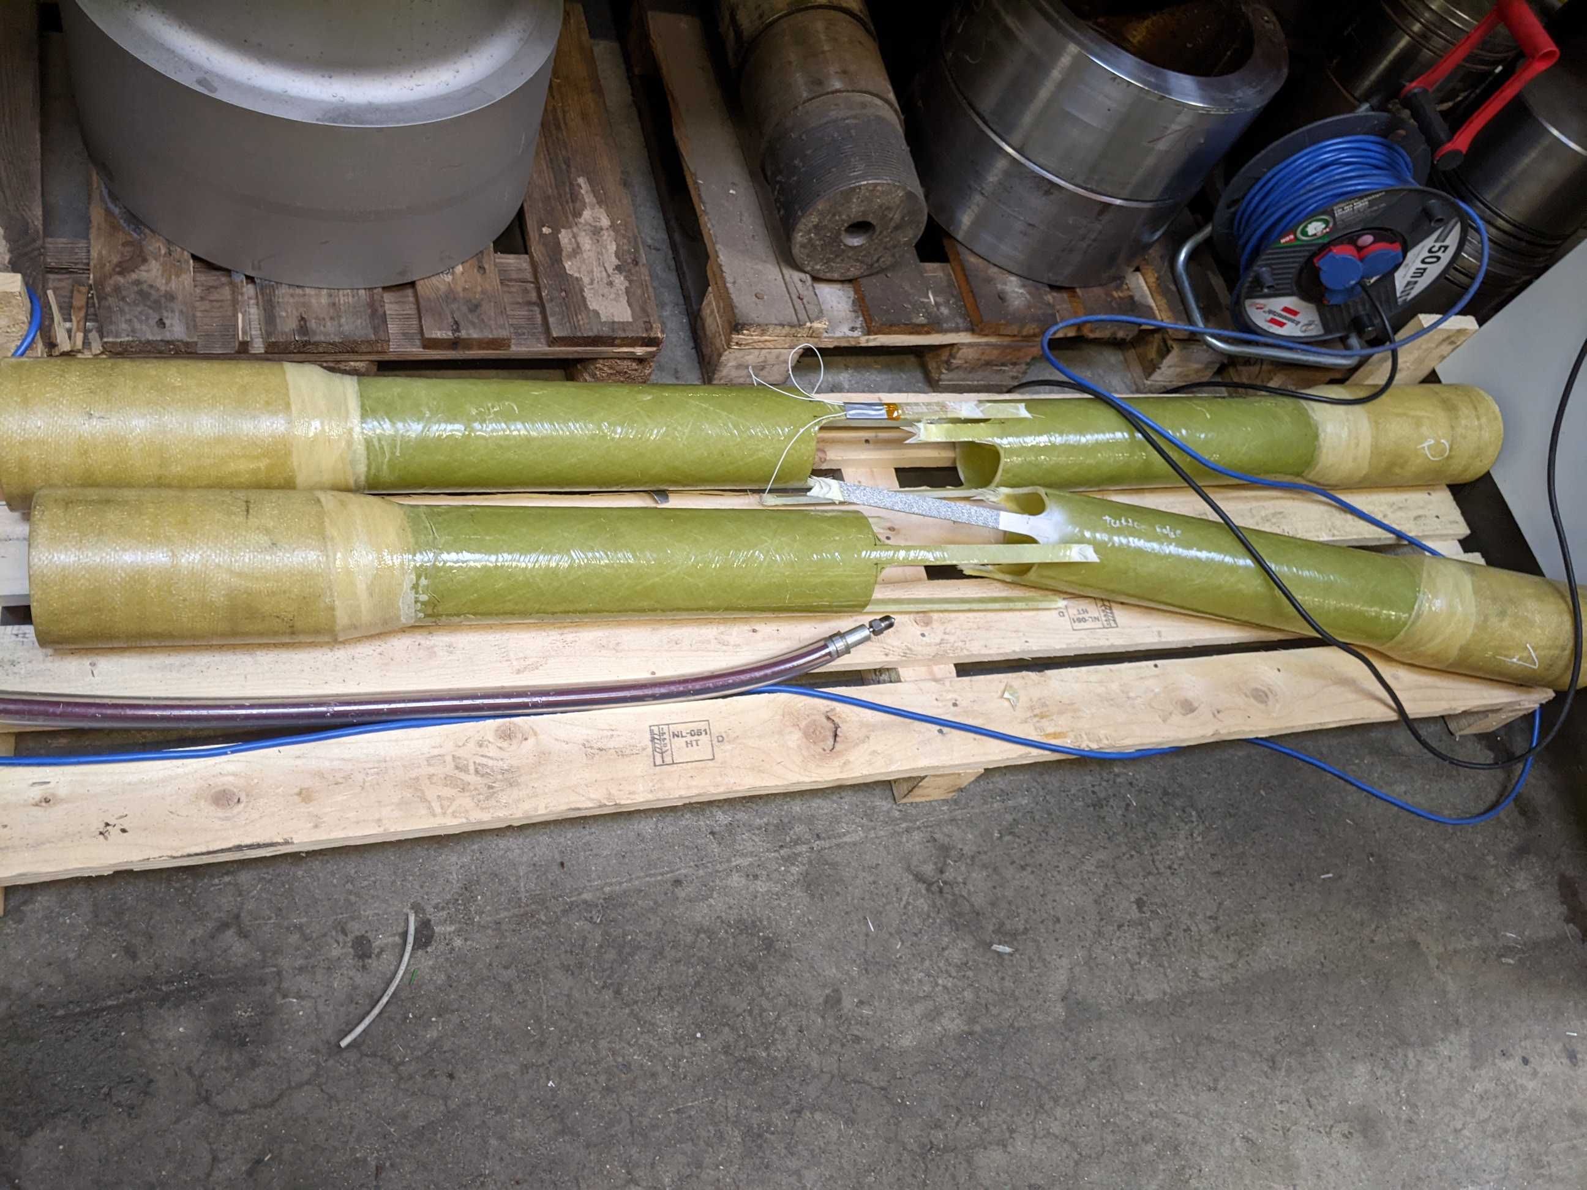
Testing and Product Verification

Slide 9
Summary of Tests
Test Type | Test series | Pipe Description | Test Facility | Max. Test Value
Standard Tensile Test | 1 | Pipe + Coupler (Carbon) | RP 4 | 660 kN
 |  | Pipe + Coupler (Glass Fibre) | RP 4 | 704 kN
 |  | Pipe + Coupler (Carbon) | RP 4 | 641 kN
 | 2 | Pipe 100 1500 psi | RP 4 | 860 kN
 |  | Pipe 100 1500 psi | RP 4 | 768 kN
TEL-Test (Cyclic Tensile Test) | 1 | Pipe 100 1500 psi | RP 4 | 600 kN
 |  | Pipe 100 1500 psi | RP 4 | 680 kN
 | 2 | Pipe 100 1500 psi | RP 4 | 190 kN
 |  | Pipe 100 1500 psi | RP 4 | 190 kN
 |  | Pipe 100 1500 psi | RP 4 | 190 kN
UEWS-Test (Cyclic Internal Pressure Test) | 1 | Pipe 100 1500 psi | Tem. Construction | 250 bar
 |  | Pipe 100 1500 psi | Tem. Construction | 250 bar
 |  | Pipe 100 1500 psi | Tem. Construction | 250 bar
 | 2 | Pipe 100 1500 psi | Tem. Construction | 320 bar
 |  | Pipe 100 1500 psi | Tem. Construction | 340 bar
 |  | Pipe 100 1500 psi | Tem. Construction | 340 bar
Collapse Test (100 mm Pipe) | 1 | Pipe 100 2000 psi | RP 2 | 198 bar
 |  | Pipe 100 2000 psi | RP 2 | 195 bar
 |  | Pipe 100 2000 psi | RP 2 | 195 bar
 |  | Pipe 100 2500 psi | RP 2 | 501 bar
 |  | Pipe 100 2500 psi | RP 2 | 393 bar
 |  | Pipe 100 2500 psi | RP 2 | 378 bar
 | 2 | Pipe 100 2000 psi | RP 2 | 230 bar
 |  | Pipe 100 2000 psi | RP 2 | 226 bar
 |  | Pipe 100 2000 psi | RP 2 | 226 bar
 |  | Pipe 100 2500 psi | RP 2 | 484 bar
 |  | Pipe 100 2500 psi | RP 2 | 478 bar
 |  | Pipe 100 2500 psi | RP 2 | 500 bar
 | 3 | Pipe 100 4000 psi | RP 2 | 881 bar
 |  | Pipe 100 4000 psi | RP 2 | 1008 bar
 |  | Pipe 100 4000 psi | RP 2 | 1018 bar
Collapse Test (200 mm Pipe) | 1 | Pipe 200 2000 psi | RP 3 | 245 bar
 |  | Pipe 200 2000 psi | RP 3 | 230 bar
 |  | Pipe 200 2000 psi | RP 3 | 262 bar

Slide 10
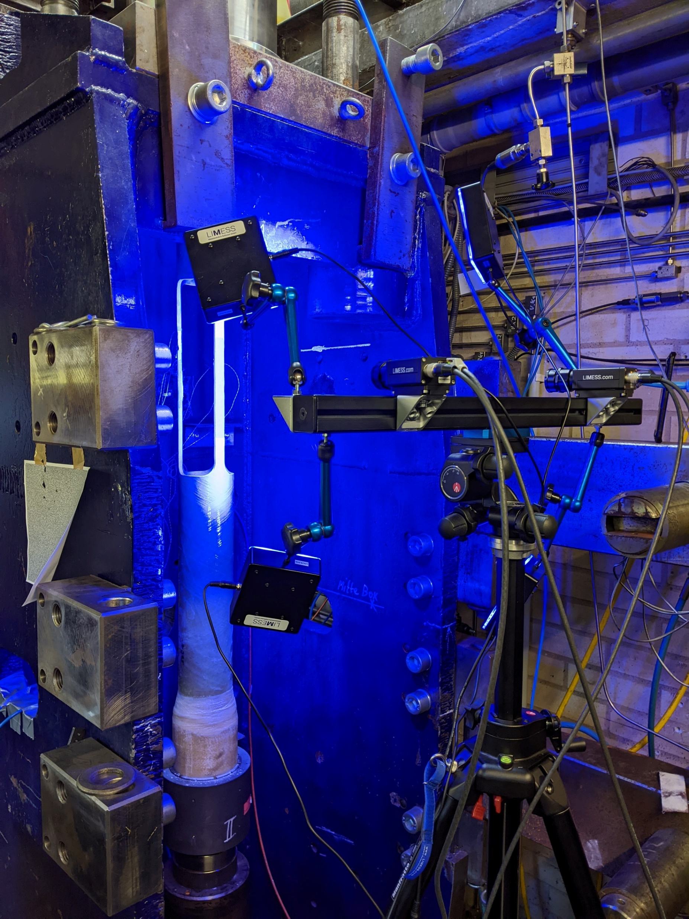
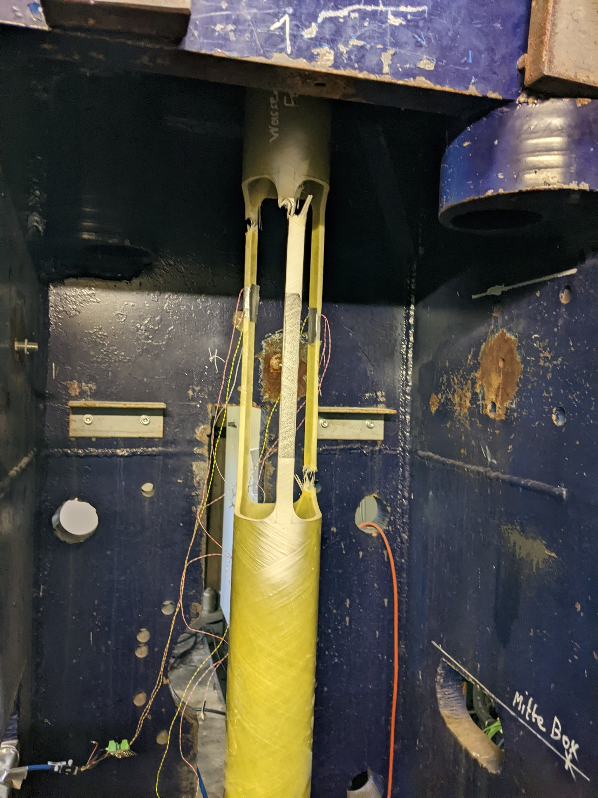
product qualification: Tensile Test
Strain Measurement
Conventional Tests fail to determine exact moment of the fiber failure.
This presents challenge to evaluating the exact process of pipe failure
Optical Strain Measurement
New set-up developed by ITE allows effective determination of the strain effect on the fibers, thereby yielding more precise data.

Slide 11
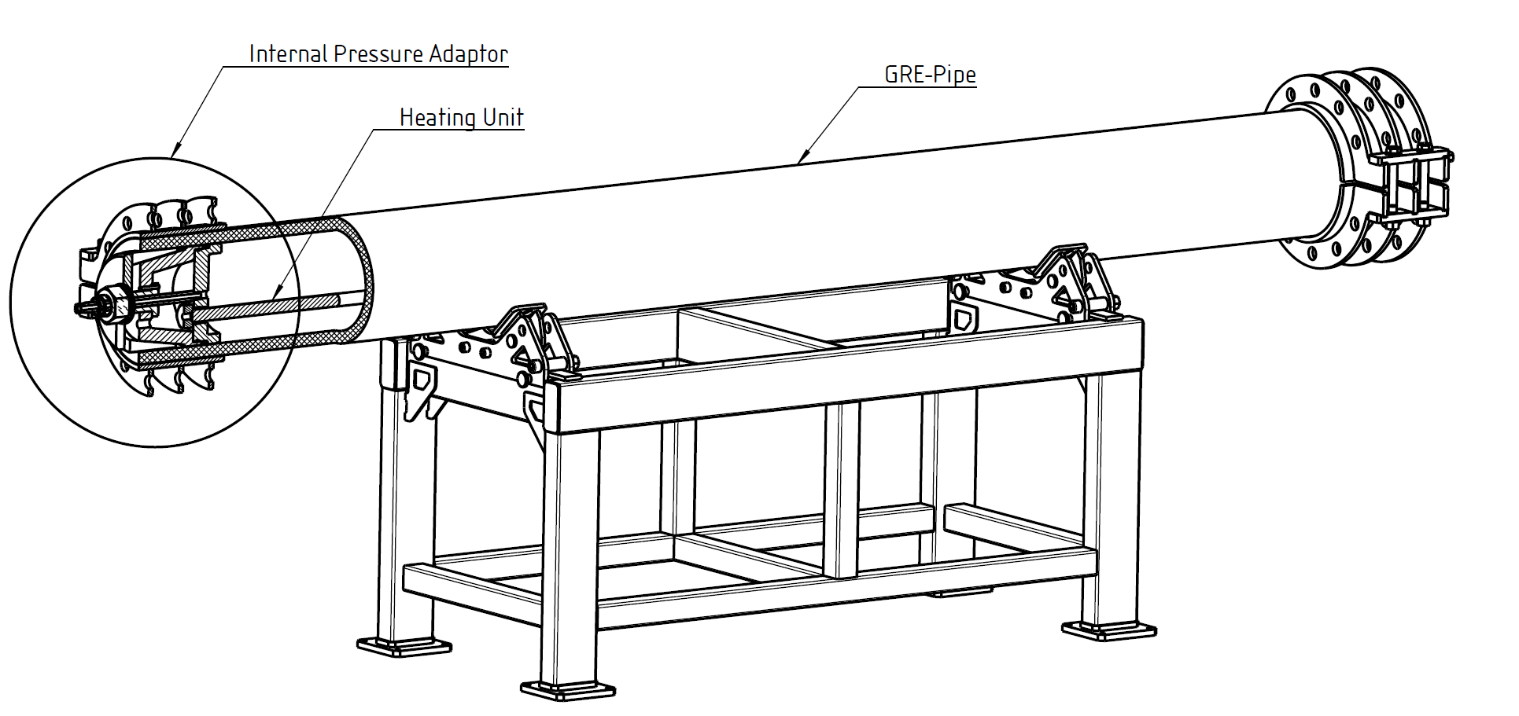
Product Qualification: Burst Test
Internal pressure and axial load test stand for long term testing
Properties
Pipe length: | 2-4 m
Max. internal pressure: | 600 bar
Heating power | 10 kW
Design temperature | 95 °C

Slide 12
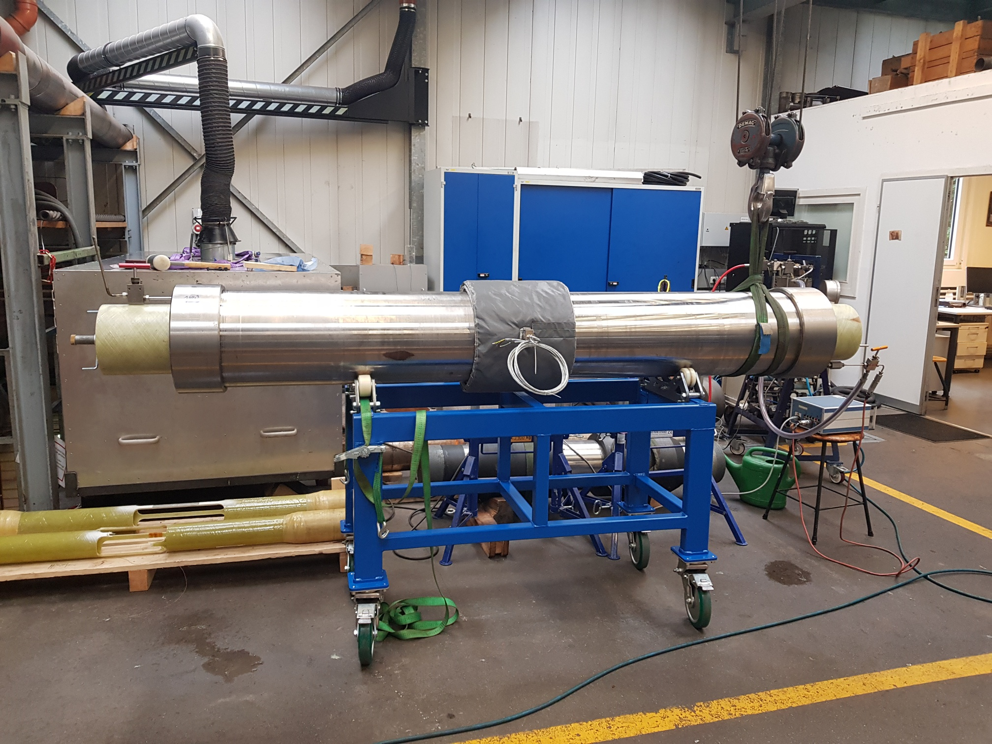
Product Qualification: Collapse Test
Testing Pipes up to 16” in OD
Collapse Pressure capacity up to 700 bar
Heating pads provide Temperatures up to 100°C
Live Monitoring of Internal & External Pressures

Slide 13
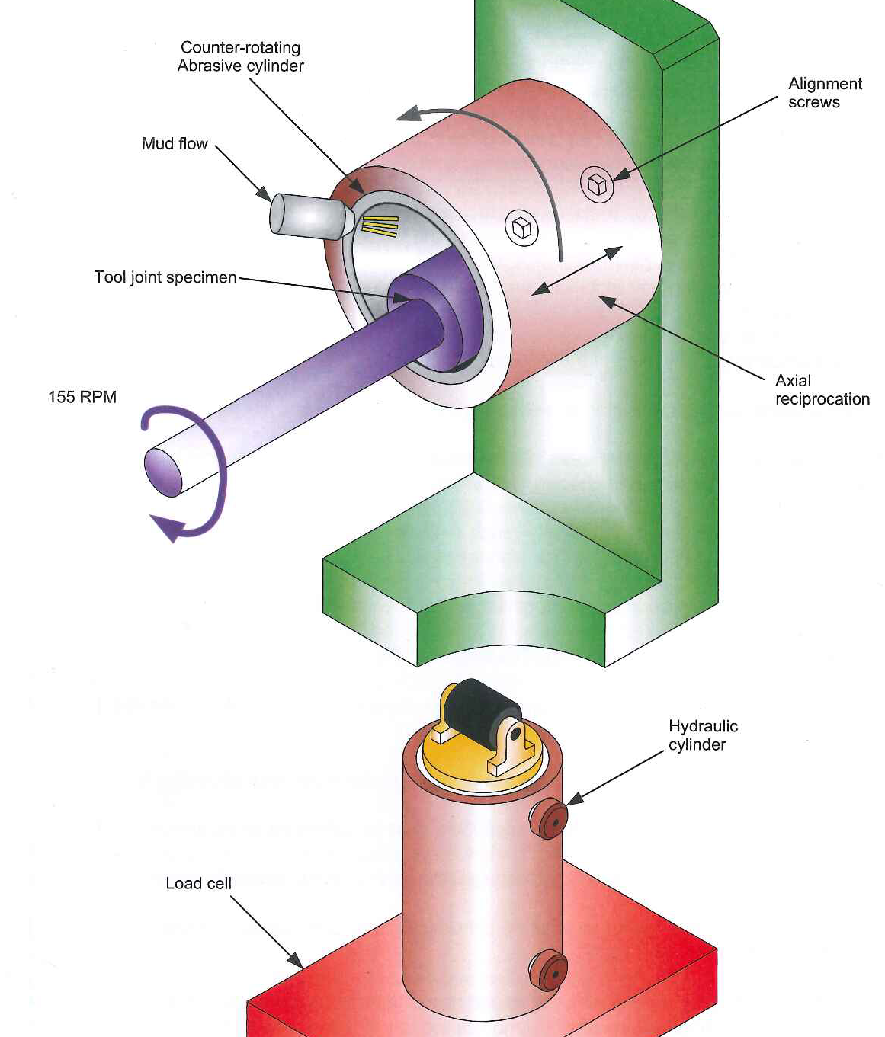
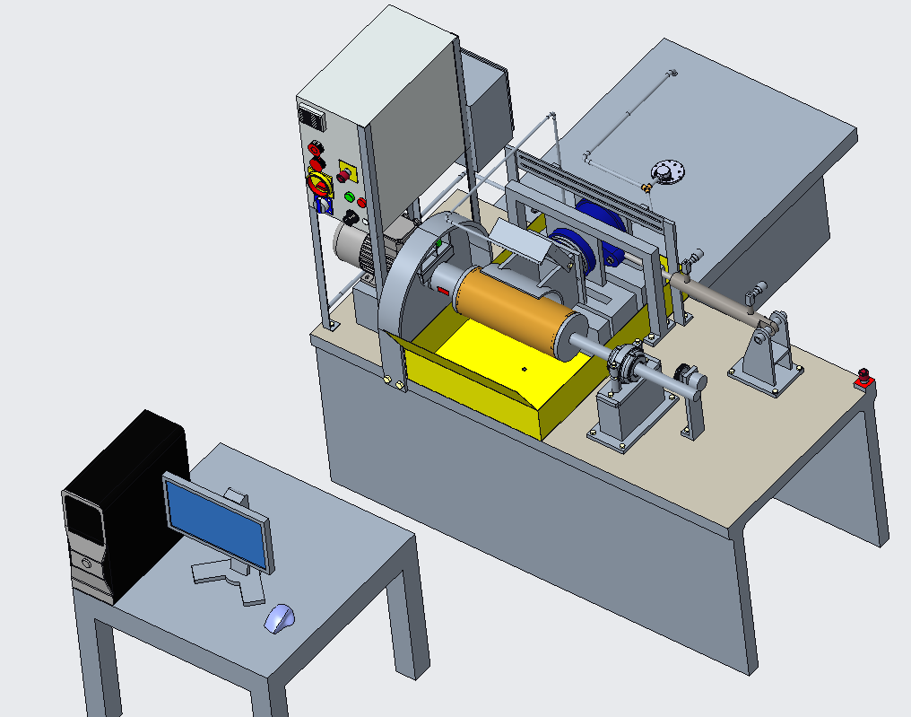
product qualification: Wear Test
Wear – Investigation of GRE pipes wear in reference to carbon steel casings
Contact geometry, material roughness, specimen alignment and contact conditions
Galling, abrasion and combined wear can be tested on the casing.
Wear factor based on worn volumes over time
Friction factor based on dry, wet and/or lubricated contact
API 7CW Wear Frame
ITE Wear Frame

Slide 14
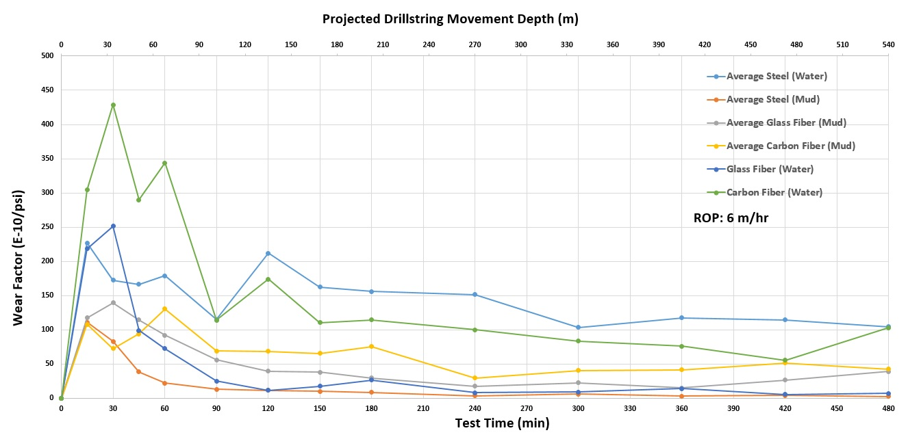
product qualification: Wear Test Results
Wear – Investigation of GRE pipes wear in reference to carbon steel casings
For GRE casing, very low friction is observed (compared to steel casing).
For GRE casing with mud, a lower friction factor is observed compared to the tests with water.
For carbon fiber, very similar friction behavior is observed for both water and mud scenarios.

Slide 15
Product Qualification: BOP Test proposal
Status
Discussion and preparation together with FPI ongoing.
Final test program issued end of this year.
Test with annular BOP and shear RAM BOP planned.
Annular BOP Sketch
BOP Stack (onshore)
Shear RAM blades

Slide 16
Equipment Manufacturing: Make-Up/Break-out unit
Status
Advantages
  Full automation possible.
  Drag/Friction between pipe and belt adjustable.
  Design of belt quite flexible (lot of types on market).
  Torque adjustable.
  Change in diameter can be adjusted with gear bolt end point.
Disadvantages
  Friction dependent on surface condition of pipe.
  Friction cannot infinitely increase by continuous belt tensioning.
  May need different inserts for diameter ranges.
  Break connections with same set up still to be confirmed (only low break-out torque possible).
Working sequence

Slide 17


Project Milestones
Project Start 2020
Pipe Design
Product Testing
Feasibility Study
Field Test
Market Study
Well Design
Product Verifcation
Code Drafting
Commercially Available Product 2023

Slide 18
Thank you for your attention!

Slide 19


Introduction to Consortium Members
Vulcan Energy Engineering GmbH, Germany, main coordinator
DrillTec GUT GmbH, Germany
TU Clausthal (ITE), Germany
Future Pipe Industries (FPI), The Netherlands, national leader
Dynaflow Research Group DRG, The Netherlands
Nuclear Research and Consultancy NRG, The Netherlands
Eartha AG, Switzerland
Service Industriels de Genève, Switzerland, cooperation partner

